Slide 1
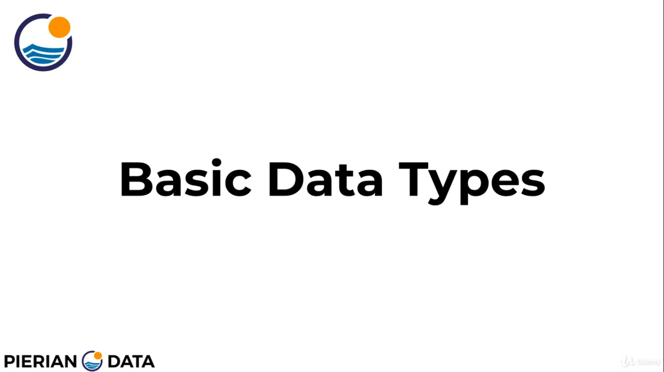

Slide 2
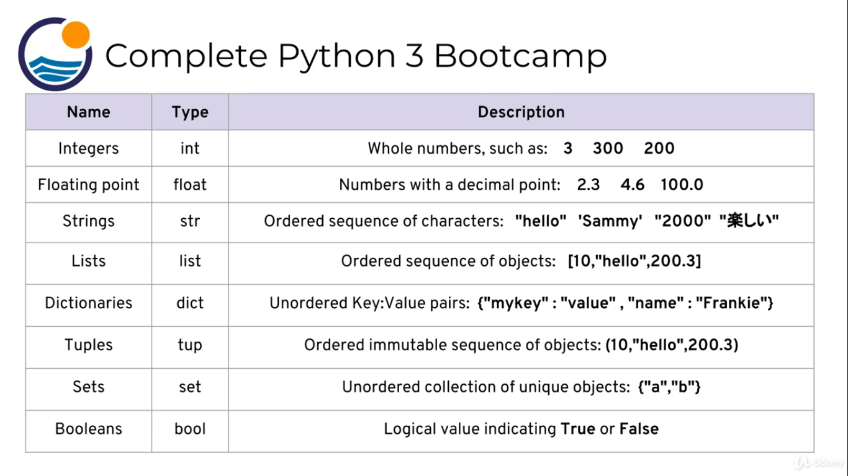
OBJECTS
DATA
STRUCTURES

